Slide 1
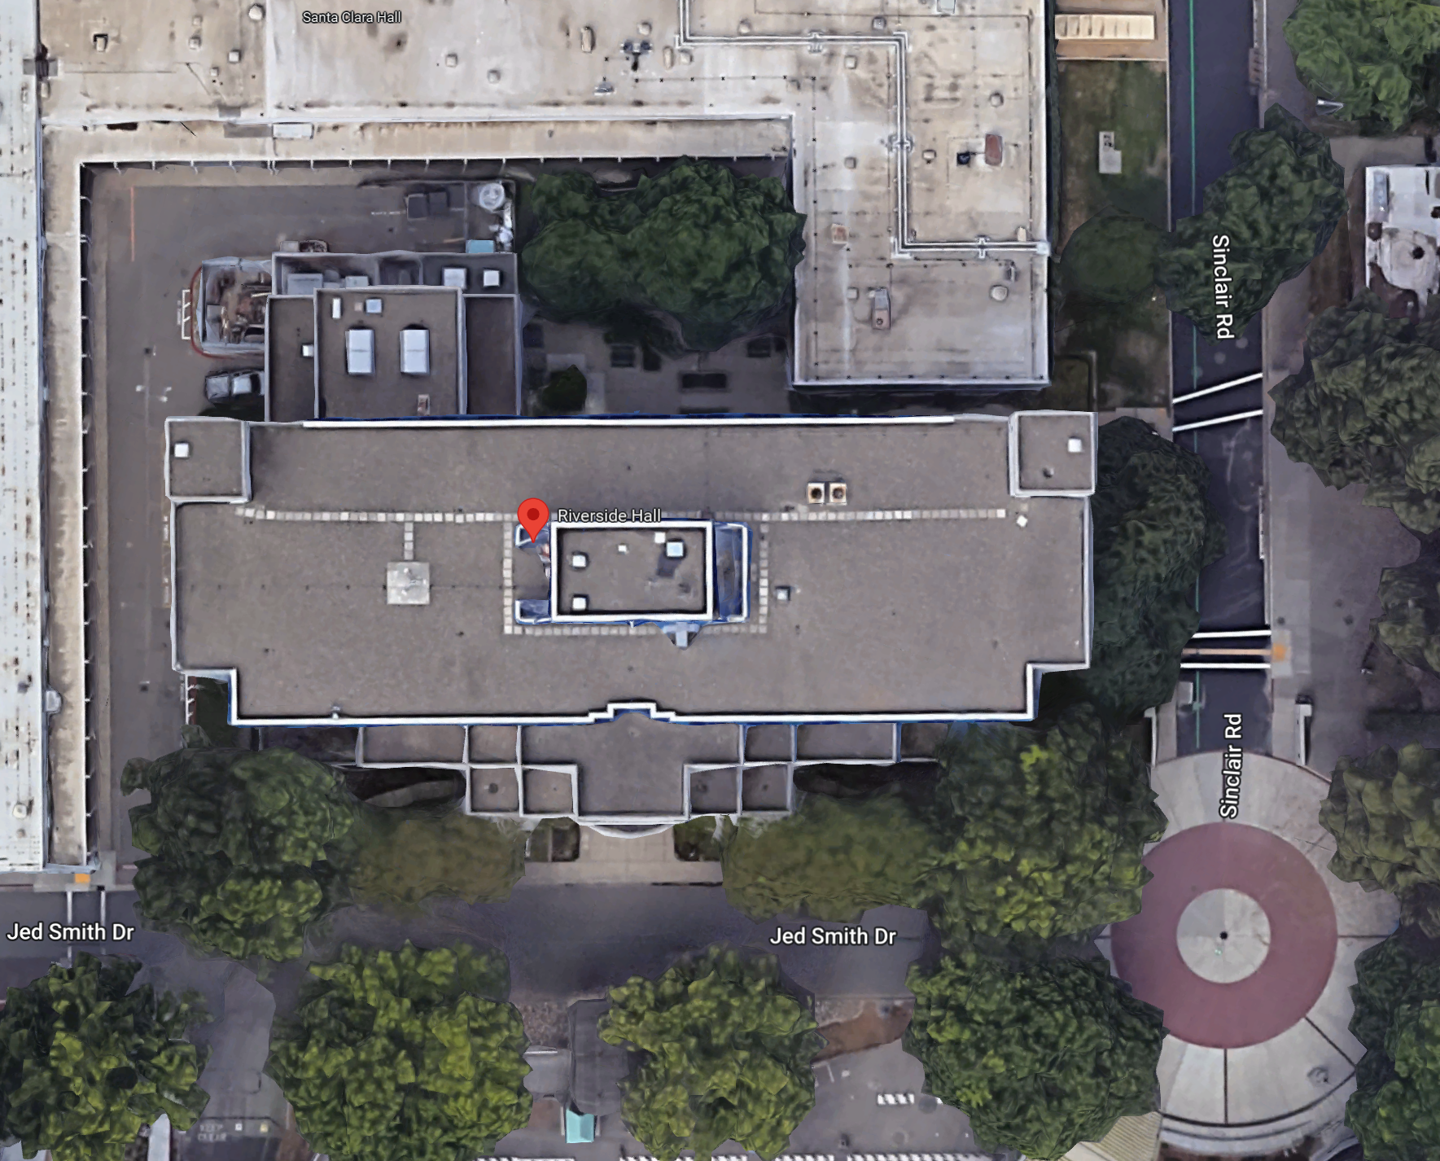
ME Senior Projects
EEE/CPE Senior Projects
CSC Senior Projects

